Slide 1

Propositions for FDSN and Marine Seismology Standards
The FDSN WG5 Action Group on Marine Seismology Metadata and Data Standards*
*Wayne C. Crawford¹, Kasey Aderhold², Yinshuang Ai³, Jerry Carter², John A Collins⁴, Carlos Jorge Corela⁵, Susanne Hemmleb⁶, Takehi Isse⁷, Joel D. Simon⁸, Maria Tsekhmistrenko⁹
¹IPGP, CNRS & Univ. Paris Cité; ²Earthscope Consortium; ³Inst Geol. & Geophys., Chinese Acad. Of Sci.; ⁴Woods Hole Oceanographic Inst.; ⁵Inst. Dom Luiz, Fac. Ciencias da Univ. Lisboa; ⁶Helmholtz Centre Postdam GFZ German Research Center for Geosci.; ⁷Univ. Tokyo; ⁸Princeton Univ.; ⁹Univ. College London

Slide 2
Overview
Goal: Define/identify standards for marine seismology data and metadata
Time Period: Sept 2023-present (2 years, bimonthly meetings)
Members: 4 North America, 4 Europe, 2 Asia
Subjects:
StationXML standards
miniSEED standards
Source identifier standards
Software

Slide 3
Major Issues
Clock drift
Leapseconds
Data completeness
Leveling systems
Positions and Orientations

Slide 4
Outputs
Proposals for new FDSN standards (or documentation)
Source identifiers
StationXML
miniSEED?
Document reference/guide for marine seismology data providers
Identification of fields that still need work

Slide 5
Proposals: Source Identifiers
In documentation
If a component’s angle relative to another component is known, but it’s absolute angle is not, the given angle should be the relative angle, and “plusError” and ”minusError” should be set to 180.
if there are two orthogonal horizontal channels that are not known to be aligned to N and E, they be named 1 and 2, with 2 oriented 90° clockwise of 1 when viewed from above.
If the vertical channel is inverted, name it “3”

Slide 6
StationXML metadata
Interim StationXML elements:
Used while waiting/proposing a new StationXML element. Elements are :
A JSON string in a <Comment><Value> or <Equipment><Description>

Slide 7
Proposal: StationXML metadata
Clock drift
New Element at Station level
<ClockDrift>
<Type>str</Type> # “piecewise_linear”, “cubic_spline” or “polynomial {a0} {a1} {a2}…”
<Instrument>
<Model>str</Model>> # e.g. “Seascan MTCv4.1”
<NominalDriftRate>float</NominalDriftRate> # e.g. 10^-8
<Reference>str</Reference> # e.g. “GNSS”, or “cross-correlated station XXX”
<SyncTime>
<Instrument>datetime</Instrument><Reference>datetime</Reference>
<\SyncTime>
<SyncTime> <Instrument>datetime</Instrument><Reference>datetime </Reference><\SyncTime>
...
</ClockDrift>
Interim Element:
<Comment subject=“Clock drift”><Value>{type: {“piecewise_linear”}, instrument: {model: 'Seascan MCXO’, nomimal_drift_rate: 1e-8}, reference: ‘GNSS’, synctimes: [ {instrument:"2016-09-10T00:00:00Z", reference: "2016-09-10T00:00:00Z”},_instrument:"2017-01-12T00:00:01Z", reference:"2017-01-12T00:00:00.415Z »}, {instrument:"2017-07-13T11:25:01Z", reference:"2017-07-13T11:25:00.6189Z »}]}</Value></Comment>

Slide 8
Proposal: StationXML metadata
Clock drift
If we expect drift but no drift was measured
Empty element (or allow <Instrument> subelement?)
<ClockDrift></ClockDrift>
Documentation: The instrument sync times must be leapsecond-corrected
GFZ-style Instrumentation IDs

Slide 9
Proposal: StationXML metadata
Leveling system
Proposed new element at Channel-level
LevelerType element derived from EqupimentType, with an additional <Relevel> subelement:
<Leveler>
<Relevel>
<Threshold units=‘degrees’>float</Threshold> # degrees from level at which relevel is triggered
<Accuracy units=‘degrees’>float</Accuracy> # relevel returns to at most this offset from level
<MaxInterval units=“hours”>float</MaxInterval> # longest time passed between level checks
</Relevel>
</Leveler>
Interim Element
<Equipment>
<Type>Leveler</Type>
<Description>{relevel: {threshold.deg: 2.5, accuracy.deg: 0.25, max_relevel_interval.h: 168}, description: ‘SIO-Nanometrics BBOBS leveling system’}</Description>
<Manufacturer>Scripps Inst. Oceanography</Manufacturer>
<SerialNumber>FR02</SerialNumber>
</Equipment>

Slide 10
Proposal: StationXML metadata
Documentation
Add a pressure sensor to the StationXML Response Examples
Hydrophone
Also Differential and Absolute Pressure Gauges?

Slide 11
Proposal?: miniSEED metadata
Is there a way to specify when data is good or bad?
Existing fields?
miniSEED2 : Field 14 byte 1 = 1 (“Amplifier saturation detected”)?
miniSEED3: {‘FDSN’: {“Flags”: {“MassPositionOffscale”: true}}}
New miniSEED3 field?
{‘DataBad’: true}?

Slide 12
Marine Documentation: miniSEED data
Use msmod for leap second correction
Can it handle incorrect leap second position?
Using FDSN/Recenter/Sequence/{BeginTime, EndTime} for relevels (Type=“Gimbal”) and mass centers (Type=“Mass”)
Including shell/Python example

Slide 13
Marine Documentation: source identifers
All proposed documentation changes

Slide 14
Marine Documentation: StationXML
Positions and Orientation
Recommend setting the plusError, minusError and measurementMethod sub-elements to specify uncertainties in Latitude, Longitude, Elevation, Dip and Azimuth, and how these values were estimated.
Deployments in lakes
Remind that the <WaterLevel> element should be set to the elevation of the lake surface
Data completeness
We recommend keeping all of the recorded data, including "noisy" or "bad".
Only if we can indicate bounds of good data?
miniSEED3
{“FDSN”:{Flags:{"MassPositionOffscale": true}}}?
{“QualityControl”:{“BadData”:true}}?
Response Examples
Of any pressure sensor (hydrophone, differential pressure gauge, absolute pressure gauge) not added to StationXML Response Examples documentation

Slide 15
Marine Documentation: distinguishing clock correction levels in miniSEED DATA
The correction is the seconds to add to the original time
 | miniSEED2 | miniSEED3
NOT CLOCK CORRECTED | Quality flag = ‘D’ Field 12 bit 1 = 0 | Root/FDSN/DataQuality = ‘D’ -or- DataPublicationVersion=1
CLOCK CORRECTED | Quality flag = ‘Q’ Field 16 = correction in 0.00001s Field 12, bit 1 = 1 | Root/FDSN/DataQuality = ‘Q’ -or- DataPublicationVersion=2+ Root/Time/Correction – correction in s
Unmeasured drift | Quality flag = ‘D’ Field 14, bit 7 = 1 Blockette 500, field 10 = “unmeasured clock drift, expected order = 10^-XX” | Root/FDSN/DataQuality = ‘D’ ?????

Slide 16
Marine Documentation: distinguishing clock correction levels in miniSEED DATA
RESAMPLED data
Needs another channel code to specify modified data (none currently in Source Identifiers)
Or use extra header, as suggested in miniSEED3 “Data publication version” description:
{“ResampledData”: true}?

Slide 17
Marine Documention: Other information
Remind that if CLOCK CORRECTED and NOT CLOCK CORRECTED are provided in SDS format, they must be in the same file
Recommend providing CLOCK CORRECTED
Order in which to perform leap second and clock drift corrections
How to request additions to StationXML
New msmod versions: drift correction and leapsecond addition/correction
Saving processing steps information (Provenance/Reproducibility)
Station names for repeated deployments
Geophone wiring and polarity
Set miniSEED3 sampling rate to exact value (msmod capability)

Slide 18
Open issues
Dataloggers that correct leap seconds
Dataloggers that output StationXML metadata
List and conformity
Optional methods for applying clock drift + leapsecond corrections

Slide 19
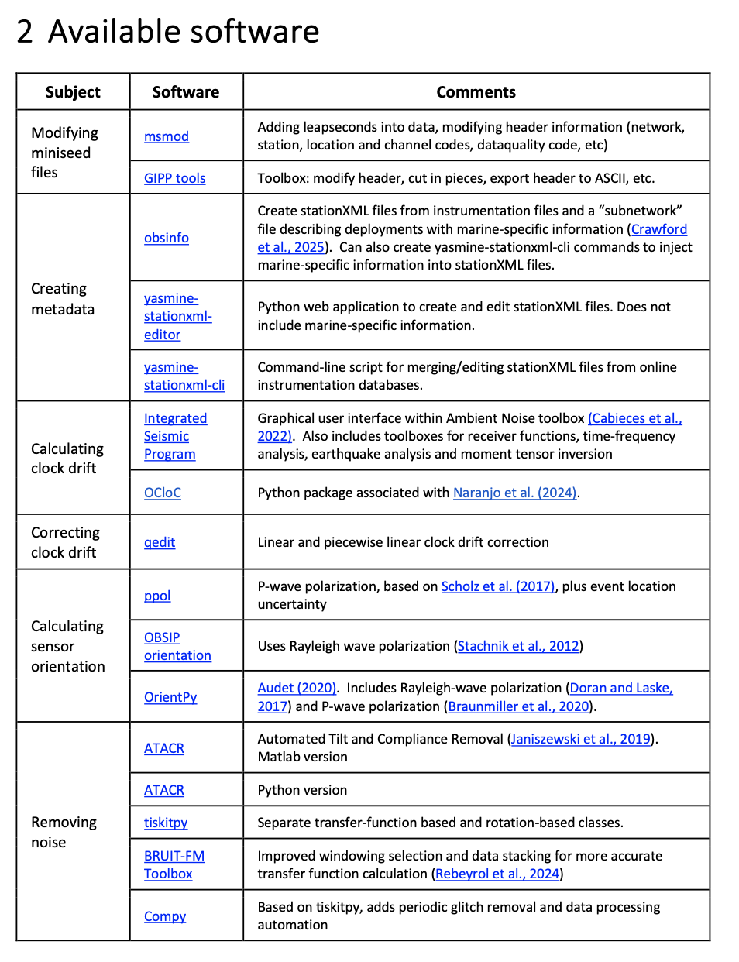
Software
There are many processes that need to be applied to most marine data (see “Subjects” at right)
Currently have a document with a list of known software (including msmod)

Slide 20
Going forward
Submit proposals to FDSN WG2
Write and publish marine documentation
Create software github + action group
Create an FDSN github site with the above list and wiki to allow users to add other software
Create an Action Group to create
Rules for validate software
Well documented (readthedocs?)
Easy Installation (conda, pip, simple Make…)
Verified on Linux + Windows + macOS + ???
List of Validated software
Integrated software? (would need funding for software engineer)

