Slide 1
FDSN Steering Committee
Opening Plenary Meeting
IAGA / IASPEI 2025
Lisbon (Auditorium A.0.6)
31 August @ 15:00 – 17:00

Slide 2
Agenda
Welcome
Adoption of the agenda
Message from the chair
Action tracking list from last plenary
Regional FDSN reports
Working Group updates (preview of WG meeting issues)
Membership updates
Proposed new Working Group
Executive Committee Nominations
Any other business

Slide 3
Welcome
Adoption of the agenda
Message from the chair

Slide 4
4. Action tracking list from last plenary
1) It was recommended that an adhoc committee/WG should be formed by Execom to:
Formulate a concept/policy document which covers the reasons and background and how to implement licensing and redistribution. The committee should look internationally and should also decide on a time frame.
Javier, Florian, Jerry, John and Mohamed will discuss

Slide 5
4. Action tracking list from last plenary
2) The WG chairs and Execom have a responsibility to update website and contacting the webmaster (webmaster@fdsn.org). Should share with all (Chairs and Execom) how to make changes. WG chairs are responsible for the content of WG pages and Execom is responsible for the rest. In addition, it was agreed that an email be sent out requesting suggestions to be sent to respective Chairs..

Slide 6
4. Action tracking list from last plenary
3) Chair and Execom to work together with IASPEI secretary general to establish a practical solution and process for management of membership fees. Perhaps request members to also make suggestions. This could also lead to changes in ToR to introduce a treasurer. In addition, there should be a request to institutions to make a commitment to become contributing members.
IUGG in the process of opening an universal account that can accommodate the associations and their commissions.

Slide 7
4. Action tracking list from last plenary
Type | Qty | Note
Supporting ($5000) | 6 | ORFEUS, EarthScope , GNS, GA, EPOS-France, CTBTO
Contributing ($1000) | 4 | UT Austin, ZRC SAZU, IPGP, NIEP
Participating | 14
Undeclared | 60
Vacant | 8 | i.e. currently no representative
Unknown | 23 | i.e. status of membership unclear
Total | 115
60/84 organizations with representatives, about 70%, did not vote.

Slide 8
4. Action tracking list from last plenary
Framework for adopting new proposals for WG’s - The WG chairs will work on the framework document and send it out for comments.
ISO Standard for sensors - It was agreed that the organisations and people that are known to be working on this aspect should be contacted in order to obtain a better understanding of where FDSN can contribute

Slide 9
5. Regional FDSN reports
Asia – Wen-Tzong Liang
Latin America and Caribbean – Xyoli Pérez-Campos
North America – Jerry Carter
Europe – Carlo Cauzzi
Africa – ?

Slide 10
6. Working Group Meetings
➔ all held in Auditorium A.0.6
WG 1: Station Siting and Instrumentation
Monday 1 September @ 12:30
WG 2: Data Exchange
Tuesday 2 September @ 12:30
WG 3: Coordination of Products, Tools and Services
Wednesday 3 September @ 12:30
WG 4: CTBT Issues
Thursday 4 September @ 12:30
WG 5: Portable Instrumentation
Thursday 4 September @ 18:00

Slide 11
WG1 (Station Siting and Instrumentation) Meeting Agenda
Metadata revision for seismic network configuration
Candidate of FDSN station
Compilation of PSD-PDF ambient noise levels

Slide 12
WG2 (Data Exchange) Meeting Agenda
Review of Proposed Agenda
Review and Approval of 2023 Minutes from Berlin
Status of 2023 Action Items and summary of activities of the last 2 years
DAS Metadata proposal
Controlled Vocabularies for Seismology
Data formats for large datasets
Recommendations/updates to StationXML from WG5
Other business

Slide 13
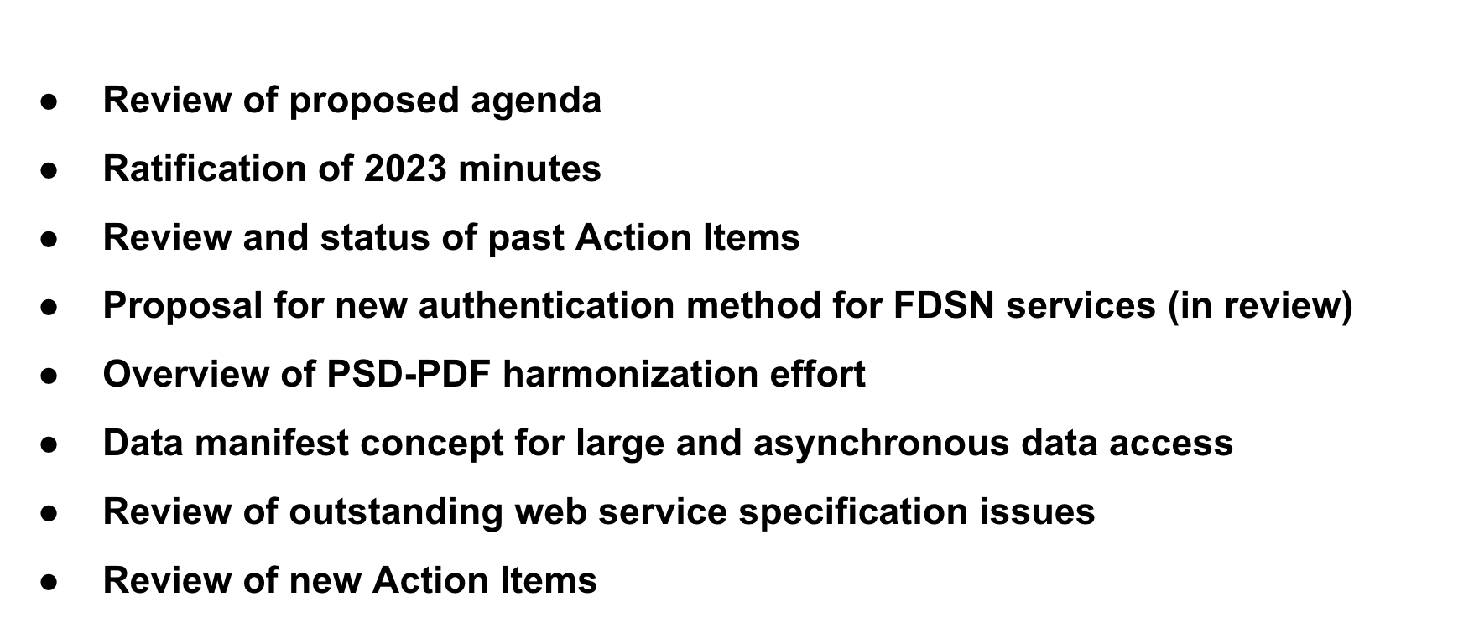
WG3 (Coordination of Products, Tools and Services) Meeting Agenda
Metadata revision for seismic network configuration
Candidate of FDSN station
Compilation of PSD-PDF ambient noise levels

Slide 14
WG4 (CTBT Issues) Meeting Agenda

Slide 15
WG5 (Portable Instrumentation) Meeting Agenda

Slide 16
7. Membership
7.1 New members
Fernando Carrilho: IPMA – Portugal
Stanka Šebela: ZRC SAZU - Slovenia
7.2 New representatives for existing memberships
Danila Chebrov: KB GS RAS – Russia
Takehi Isse: ERI – Japan
Takeshi Kimura: NIED – Japan
Anna Berezina*: IS NAS KR – Kyrgyzstan
María Cristina Araya*: UCR-ICE – Costa Rica
7.3 New representatives needed
INPRES – Argentina
BGI – Botswana
NRIAG – Egypt
KN RS RAS – Kyrgyzstan
MMERE, GSD – Soloman Islands
RCSFM MEC - Uzbekistan
* Pending nomination letter

Slide 17
8. Proposed New Working Group: Legacy Seismic Data
There are many uncoordinated efforts related to scanning analog records into image files and then vectorizing those into time series using a variety of applications.
There are almost as many ways of doing this as there are groups trying to do it.
Forming an FDSN working group for Legacy Seismic Data. ”It is begging for some standards body to do this and frankly the FDSN is the best place for this”.
It could be a working group with a limited lifetime but some organization really should try to set a standard for others to follow.

Slide 18
9. Executive Committee Nominations
Current slate: Chair Michelle Grobbelaar
Secretary Nick Ackerley
WG 1 Chair: Wen-Tzong Liang Vice-Chair: Ludek Vecsey
WG 2 Chair: Javier Quinteros
Vice-Chair: Philip Crotwell
WG 3 Chair: Chad Trabant
Vice-Chair: Marcelo Bianchi
WG 4 Chair: Spiro Spiliopoulos
Vice-Chair: Steven Myers
WG 5 Chair: Joel Simon
Vice-Chair: Yinshuang Ai

Slide 19
9. Executive Committee Nominations
Nominations:
Chair Tim Ahern
Treasurer Reinoud Sleeman
WG1 Chair Wen-Tzong Liang
Irene Molinari
Elections at closing plenary on:
Friday 5 September @ 12:30 (Auditorium A.0.6)

Slide 20
10. Any other business
Closing plenary on:
Friday 5 September @ 12:30 (Auditorium A.0.6)

Slide 21
Thank you

