Slide 1
North American Report
FDSN

Slide 2
Federated Data Centers in North America
NRCAN (Canadian National Data Center)
NCEDC (Northern California Earthquake Center) SCEDC (Southern California Earthquake Data Center) USGS (USGS Earthquake Hazards Program)
EarthScope (SAGE Data Center)

Slide 3


Canada - Earthquake Early Warning System Activation of system in British Columbia
2024-08-29
Minister Jonathan Wilkinson announces activation with Minister Harjit S. Sajjan, provincial Minister Bowinn Ma, and Member of Parliament Wilson Miao.
https://www.canada.ca/en/natural-resources-canada/news/2024/08/governments-of-canada-and-british-columbia-highlight-earthquake-early-warning-system-launched-in-western-canada-to-strengthen-ability-to-respond-to.html

Slide 4
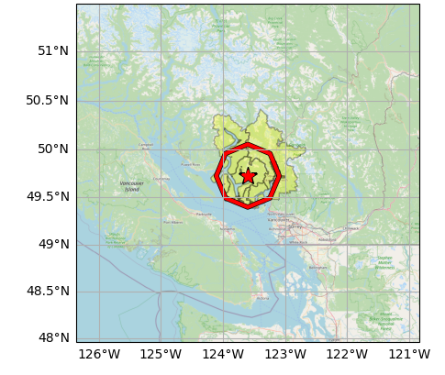
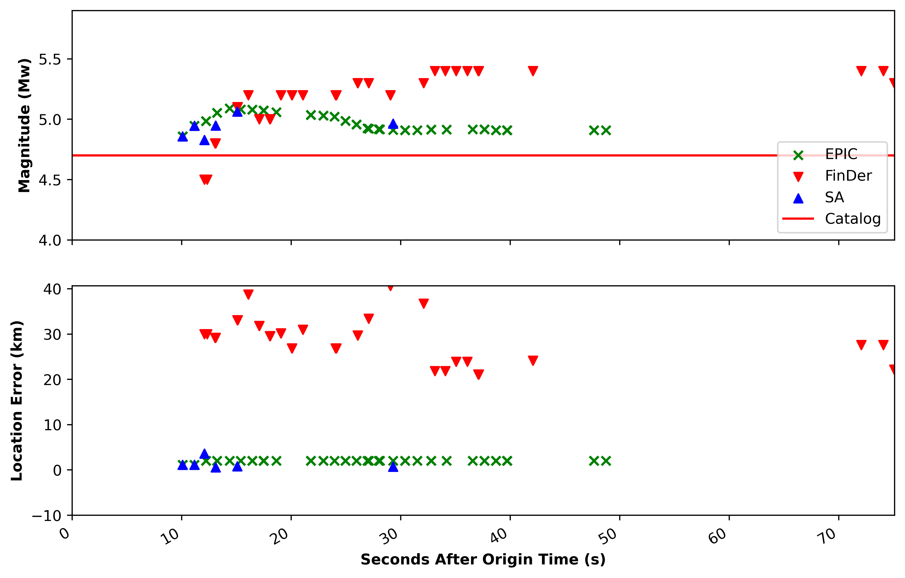
Canada - Earthquake Early Warning System First Successful Alert
Map of Alerted Areas
2025-02-21: M=4.7 – 24 km NNE of Sechelt, BC
Earthquake detection: 10.1 s
Alert generation: ~17.1 s
Alert distributed via cell phones through National Public Alerting System (NPAS)
Red polygon is area where cell phones were alerted.
Yellow polygons are areas where TV and radio broadcast an alert.

Slide 5
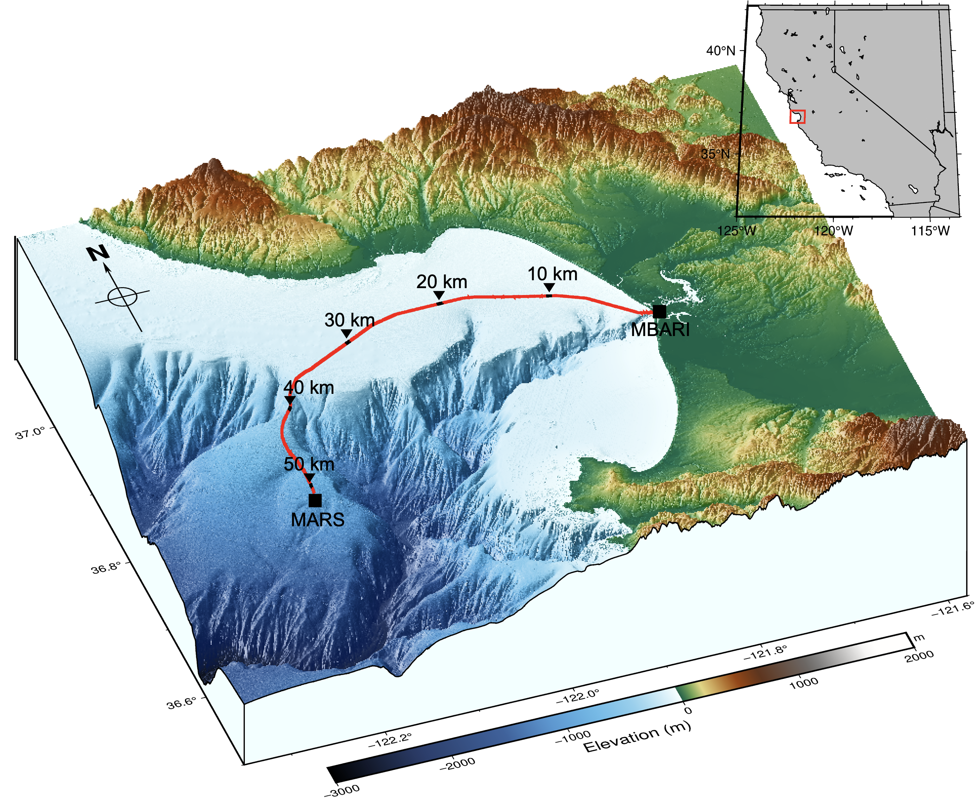
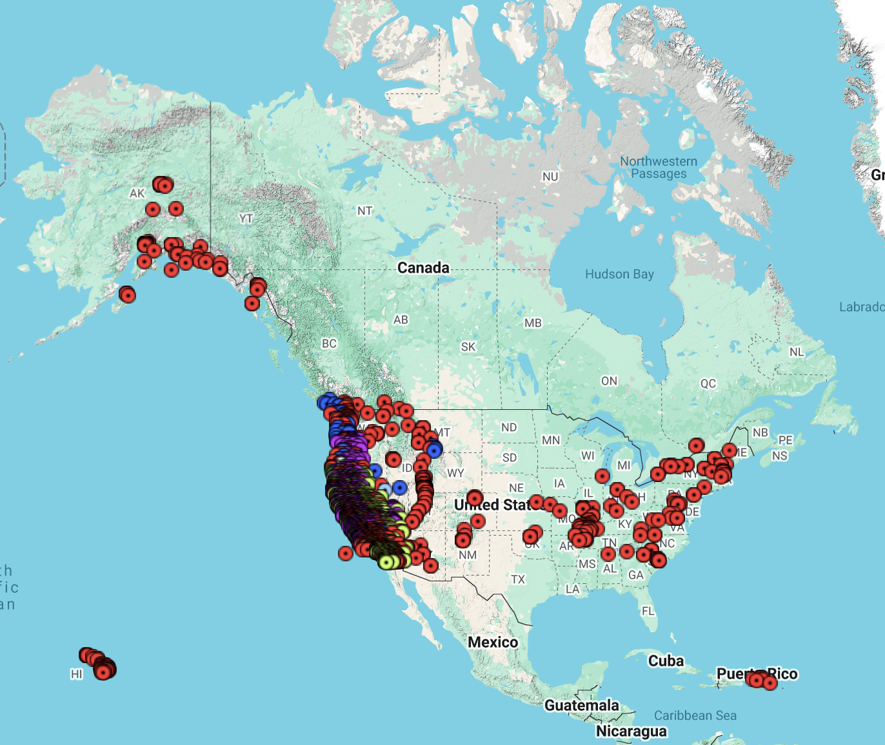
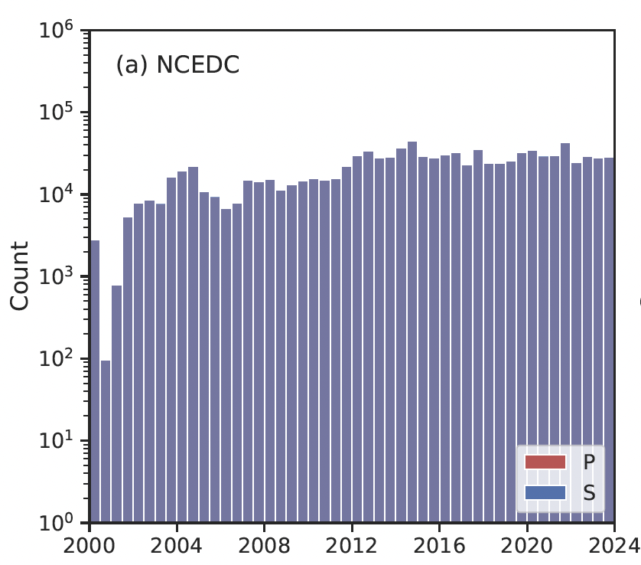
NCEDC Holdings: 184 TB; 29 Networks; 2,640 Stations New network B4: Berkeley Distributed Acoustic Sensing Network All data available through AWS Open Dataset Program A unified California Earthquake Event Dataset (CEED) to facilitate machine-learning based research
52-km seafloor cable at Monterey Bay
Romanowicz et al. (2023, SRL)
1.1M pairs of P and S picks from CEED
Zhu et al. (2025, arXiv)

Slide 6
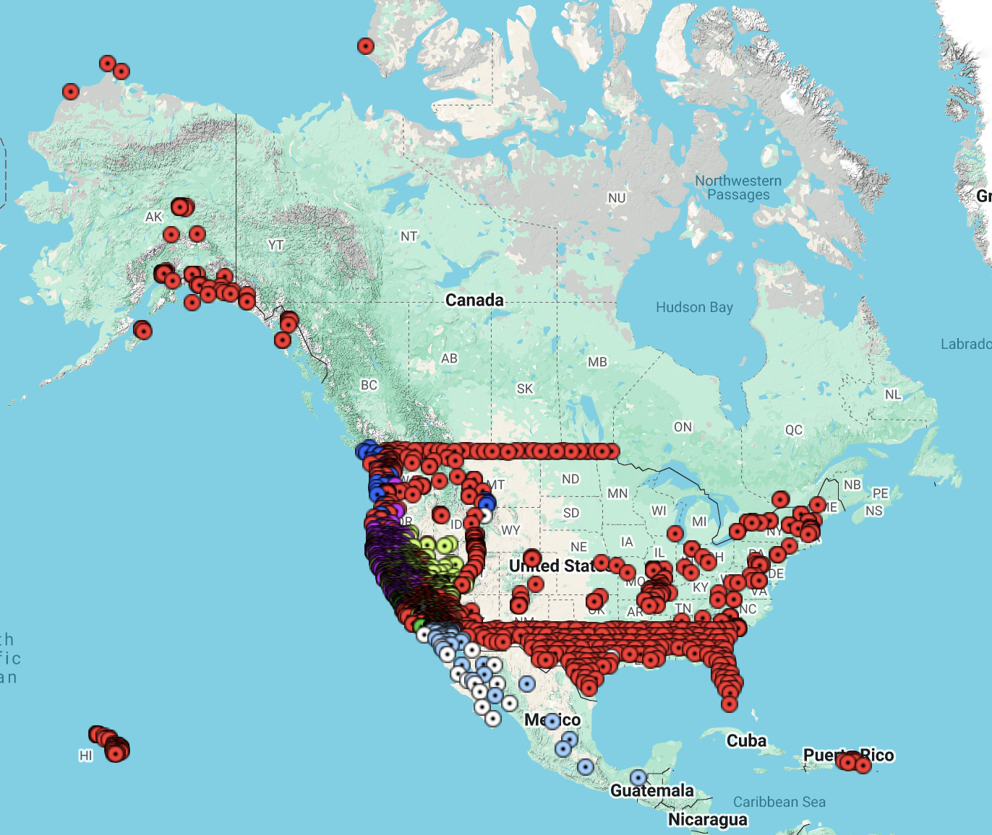
SCEDC Holdings 20 Networks 6,769 Stations, 560 in CI Data are available in AWS Open Dataset Program

Slide 7
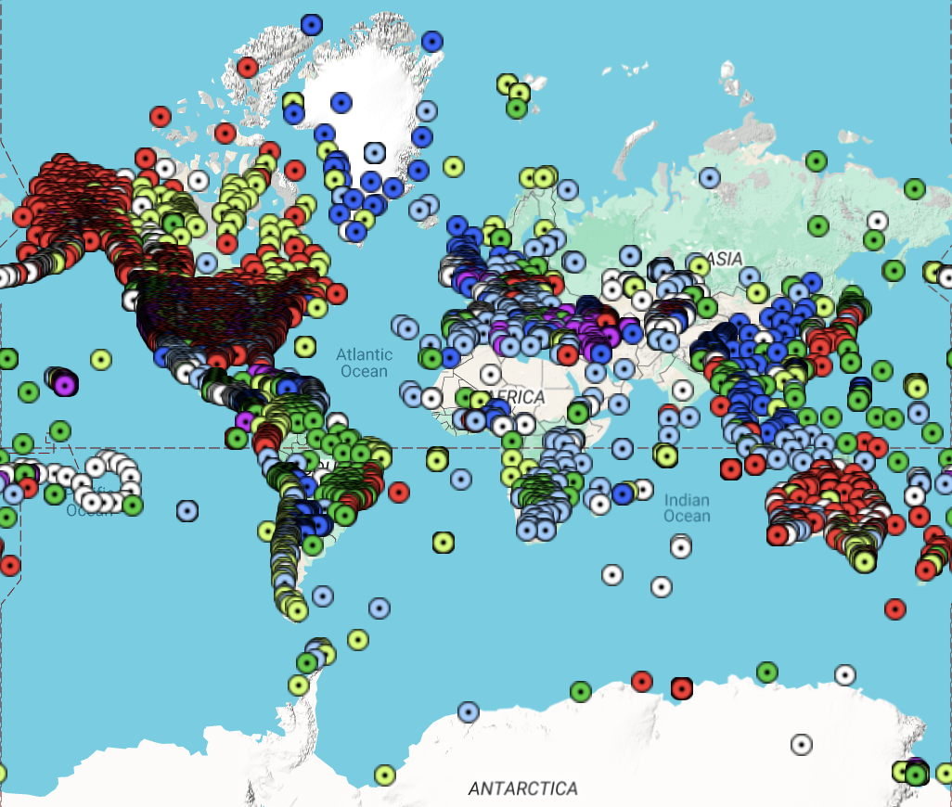
EarthScope Holdings 1,134 TB 1,077 Permanent Networks 16,301 Stations All data stored on AWS, some moving to the Open Dataset Program

Slide 8
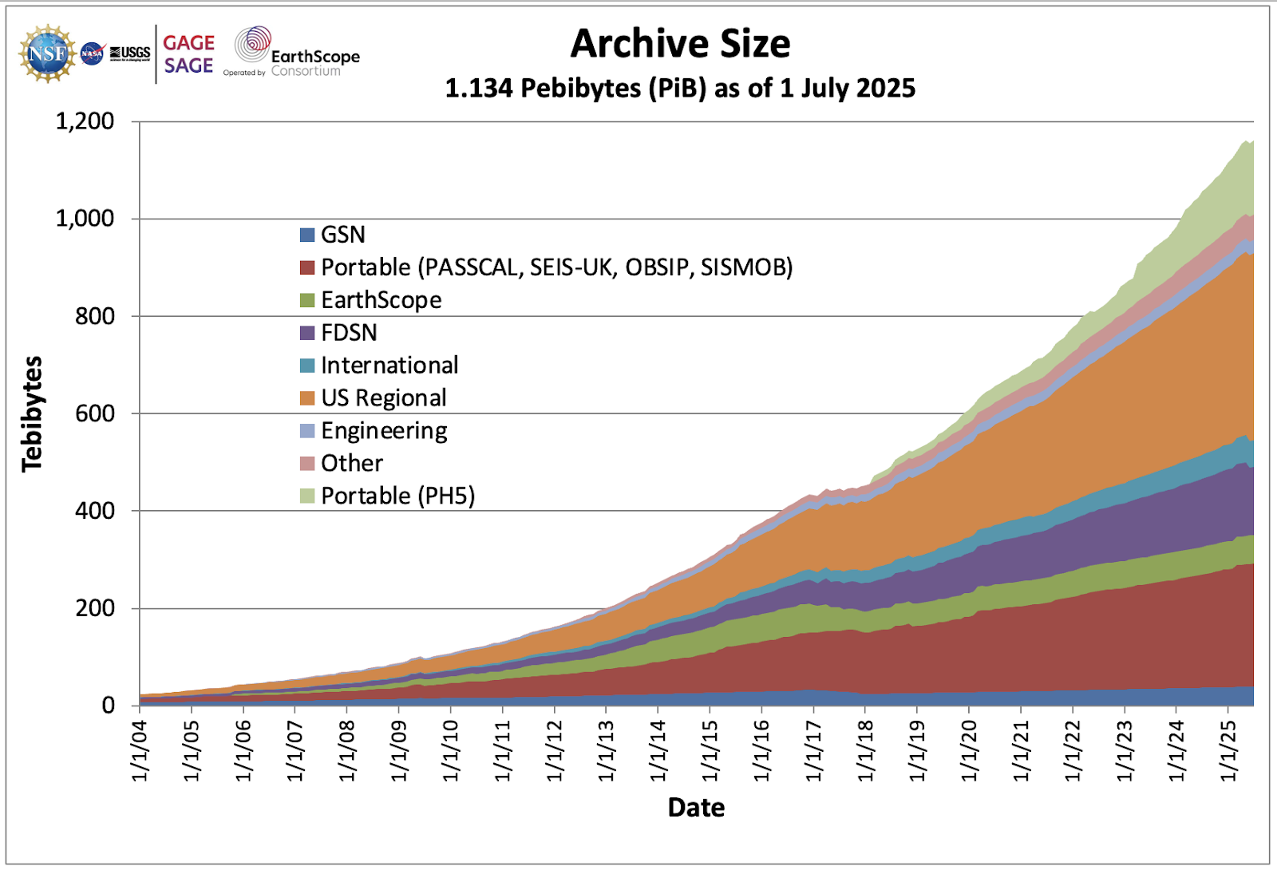
SAGE (operated by EarthScope) Data Holdings

Slide 9
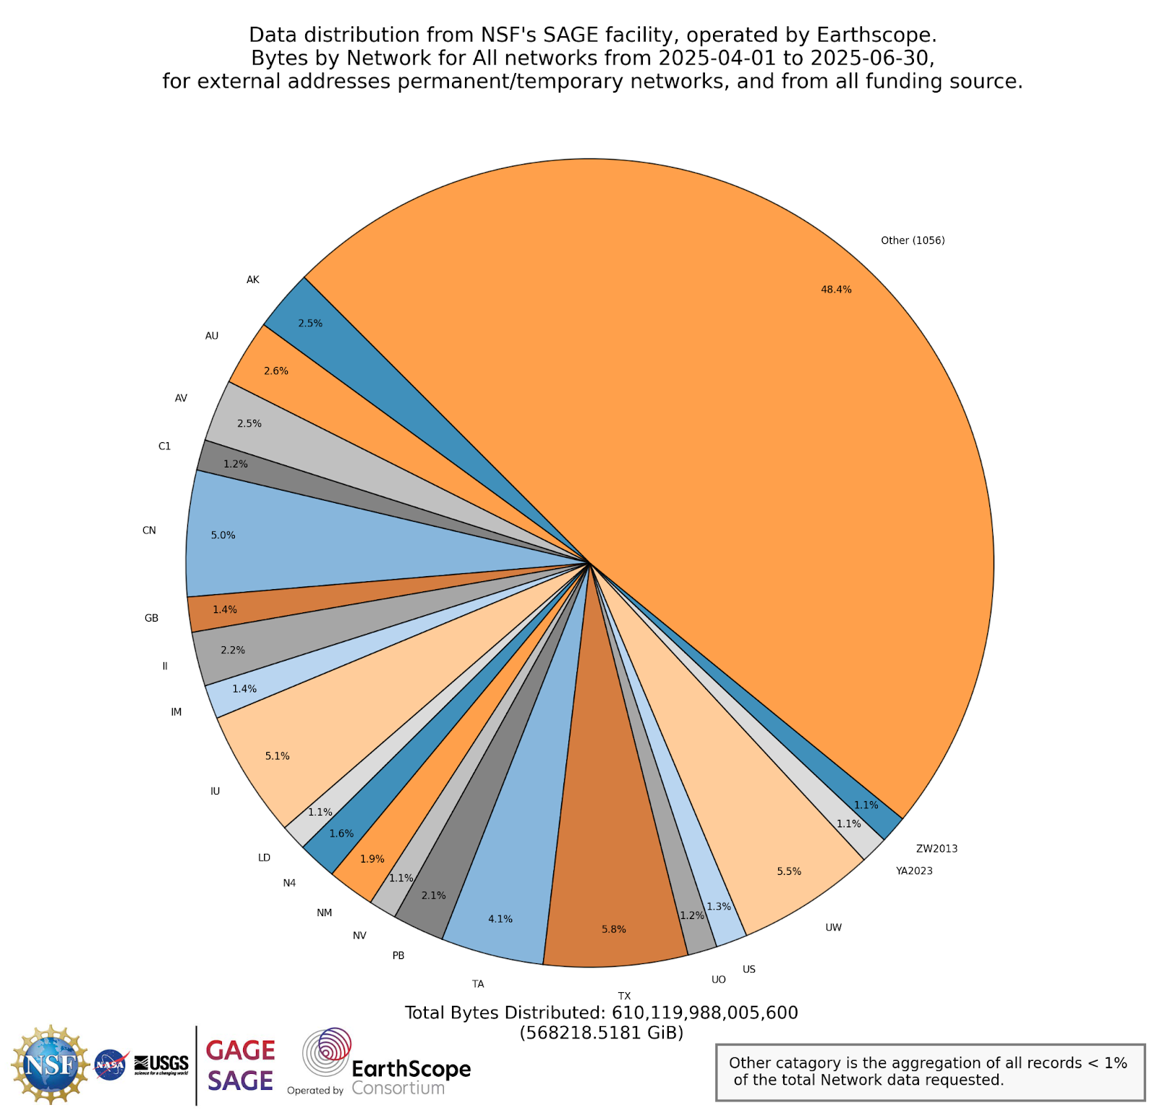
Data Distribution by Network Estimated at 2 Petabytes/Year
(based on 2025 Q2)
CN 5.0%
(Canadian National Seismograph Network)
Other 48.4%
Global Seismic Network 7.3%
(IU + II)

Slide 10
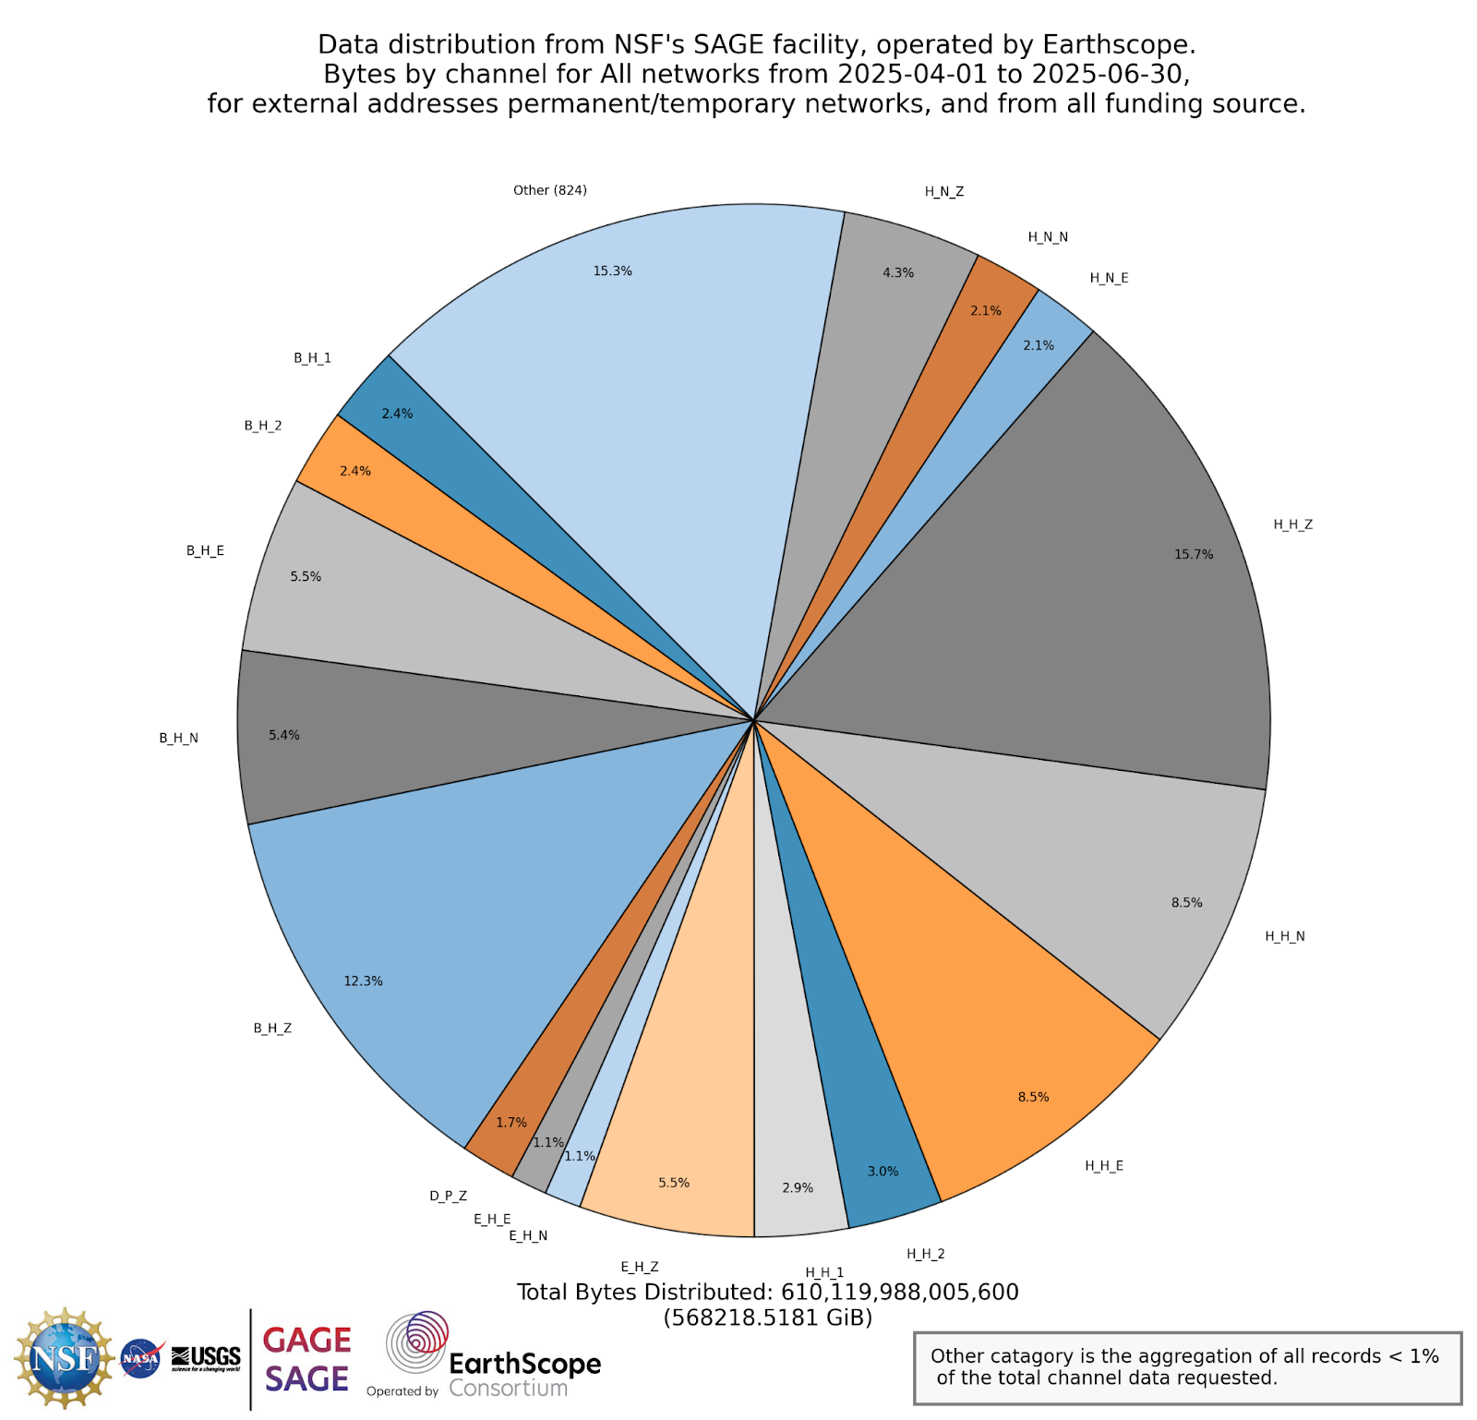
EarthScope Data Distribution
Estimated at 2 Petabytes/Year
(based on 2025 Q2)
Broad Band Channels
(B_H_?)
High Frequency Broad Band Channels
(H_H_?)

Slide 11
Activities:
Most North American data centers store data in commercial clouds which democratizes access to large datasets and compute resources.
Regrettably, data from many TC network stations (Costa Rica) have been removed as we were informed that the data will never be released as open. Data from 29 TC stations remain open and available.

