Slide 1
FDSN Asia Report
Wen-Tzong Liang
Institute of Earth Sciences, Academia Sinica, Taiwan
2025-08-31@Lisbon

Slide 2
Outline
Focused session proposed for the 2025 JpGU meeting
Current status of regional seismic networks in Asia

Slide 3
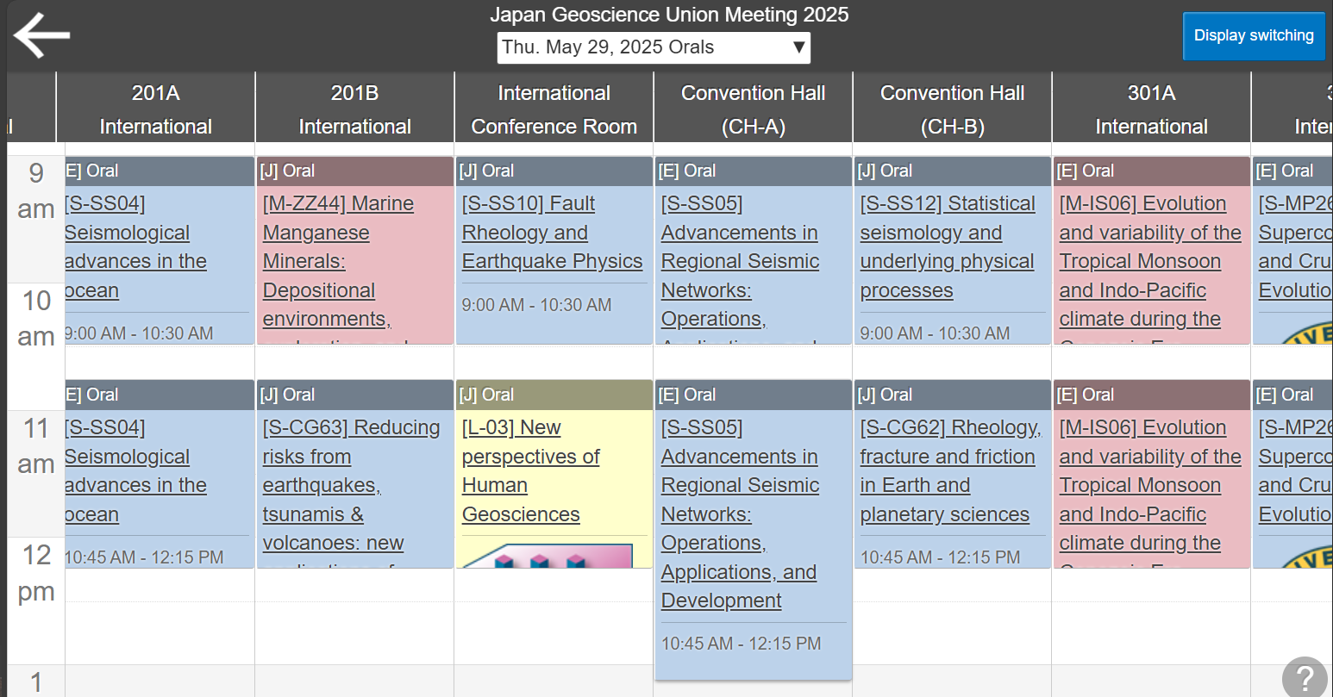
Focused Session on Regional Seismic Networks
JpGU 2025 S-SS05 Session
  Advancements in Regional Seismic Networks: Operations, Applications, and Development
  Conveners: S. Tsuboi, W.-T. Liang, N. Takeuchi, I. Takehi
  2 oral and 1 poster slots on May 29, 2025
  12 oral and 6 poster presentations
  Participants from China, German, Indonesia, Japan, Taiwan, US, Vietnam (regional netowrks)
  New FDSN standards
JpGU 2026 + AGU

Slide 4
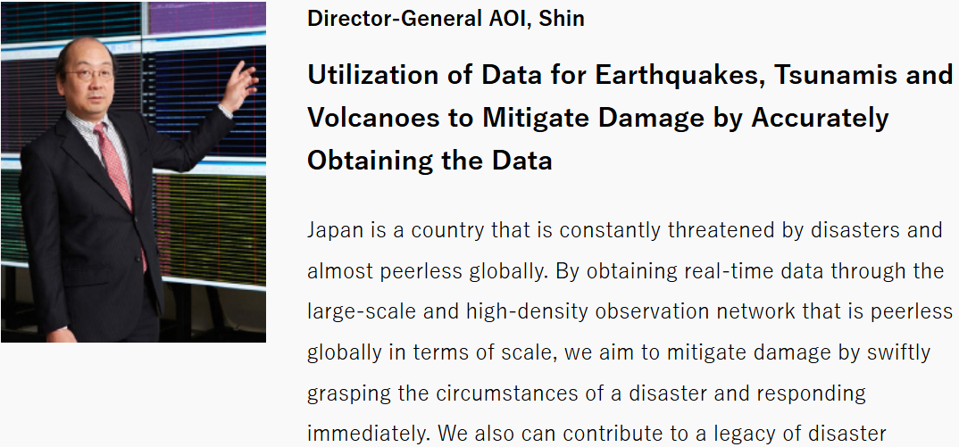
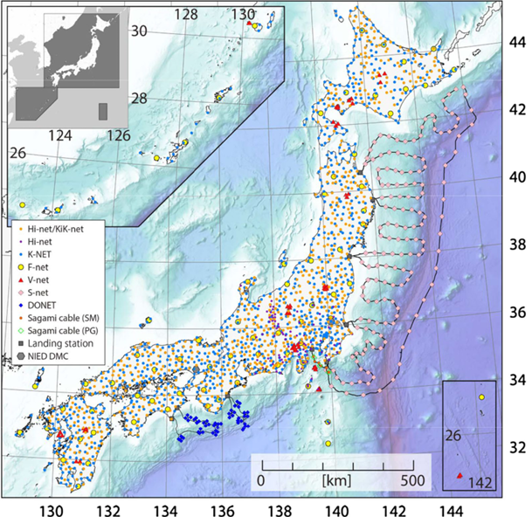
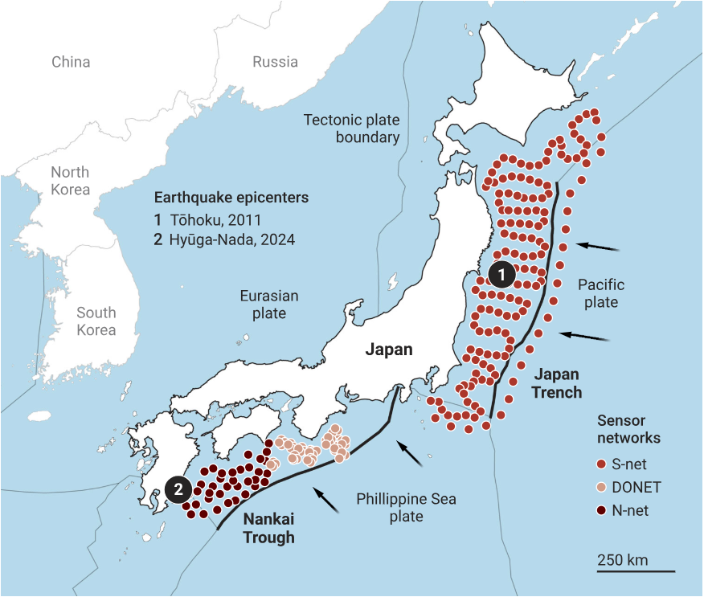
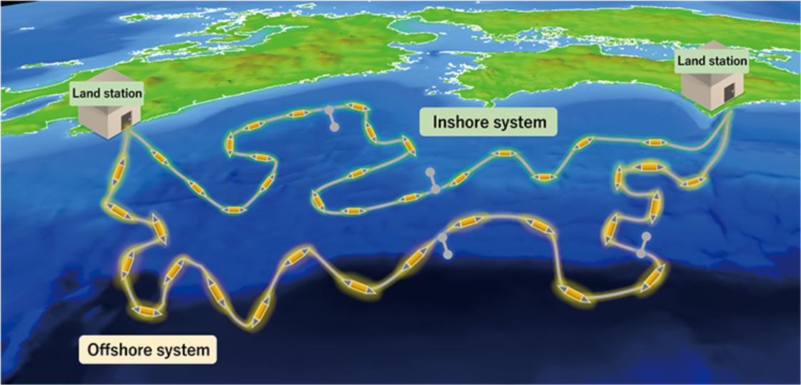
MOWLAS: NIED observation network for earthquake, tsunami and volcano
MOWLAS: Monitoring of Waves on Land and Seafloor
N-net
Aoi et al, 2020
Voosen, 2025
Notes:
The purpose of MOWLAS is to provide comprehensive, accurate, and rapid observation and monitoring of earthquake, tsunami, and volcano events throughout Japan and its offshore areas. MOWLAS data are widely utilized for long-term earthquake forecasting, the monitoring of current seismic activity, seismic and tsunami hazard assessments, earthquake early warning, tsunami warning, and earthquake engineering, as well as earthquake science.

Slide 5
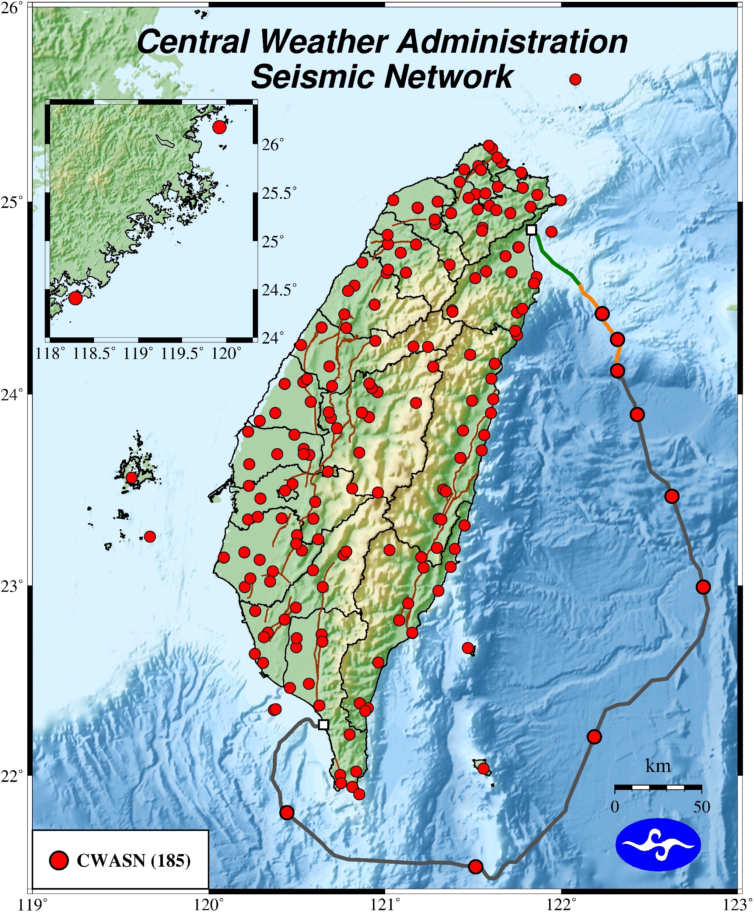
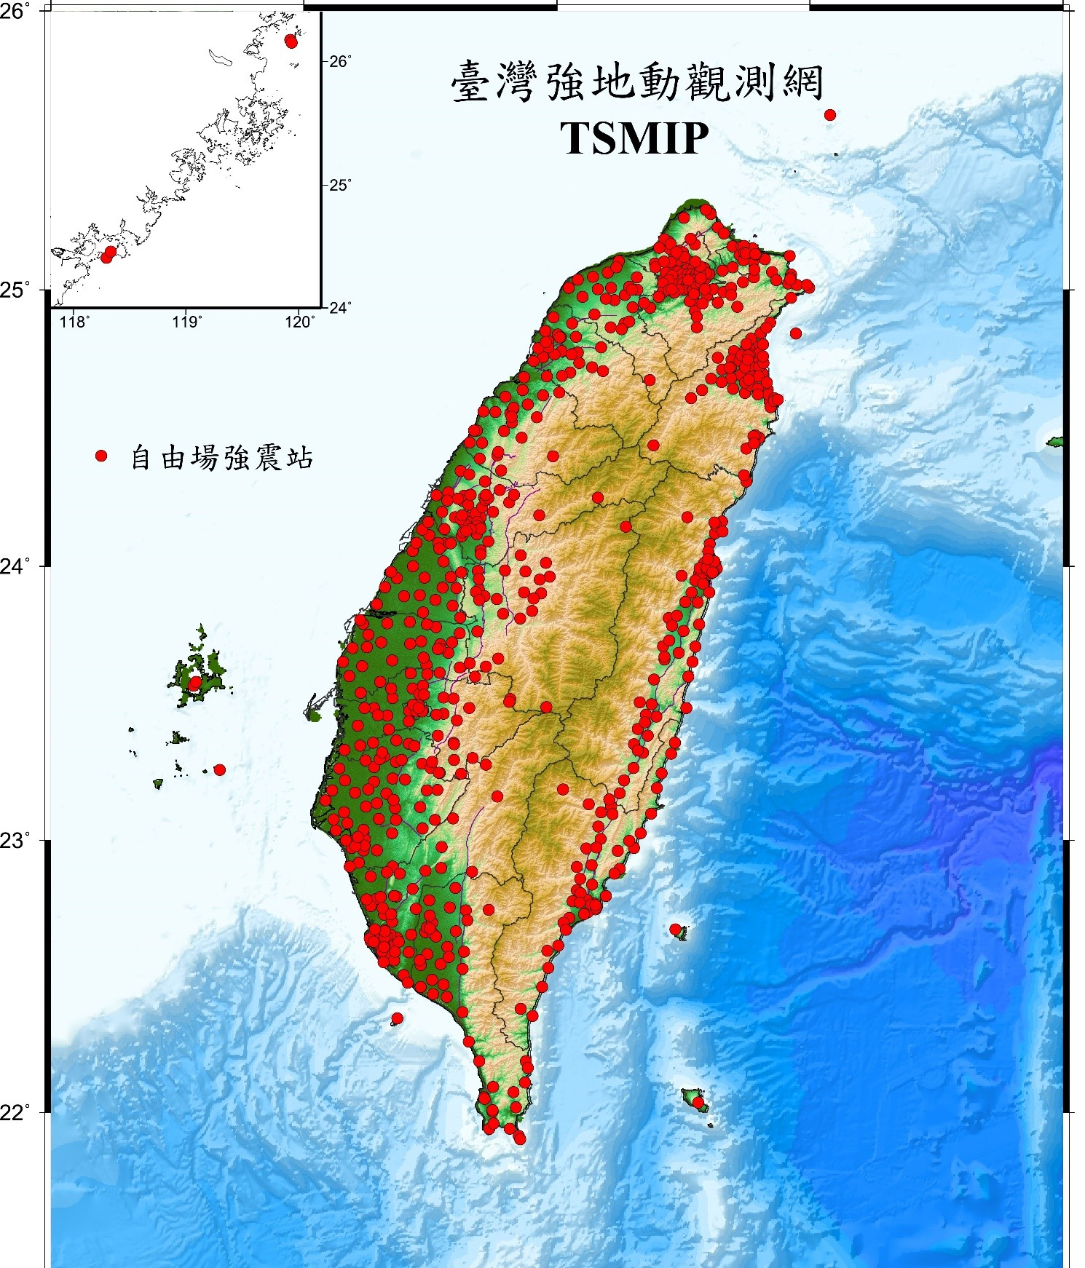
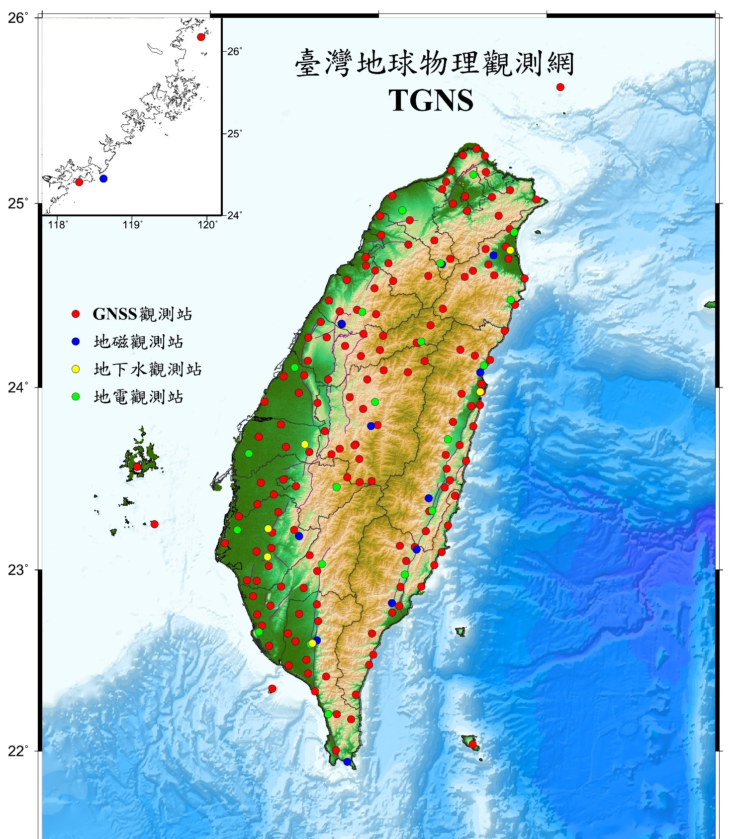
Taiwan GDMS web services
CWASN: Central Weather Administration Seismic Network (143 accessible, excluding OBS)
TSMIP: Taiwan Strong Motion Instrumentation Program (516 accessible)
TGNS: Taiwan Geophysical Network for Seismology (267 GNSS accessible)

Slide 6
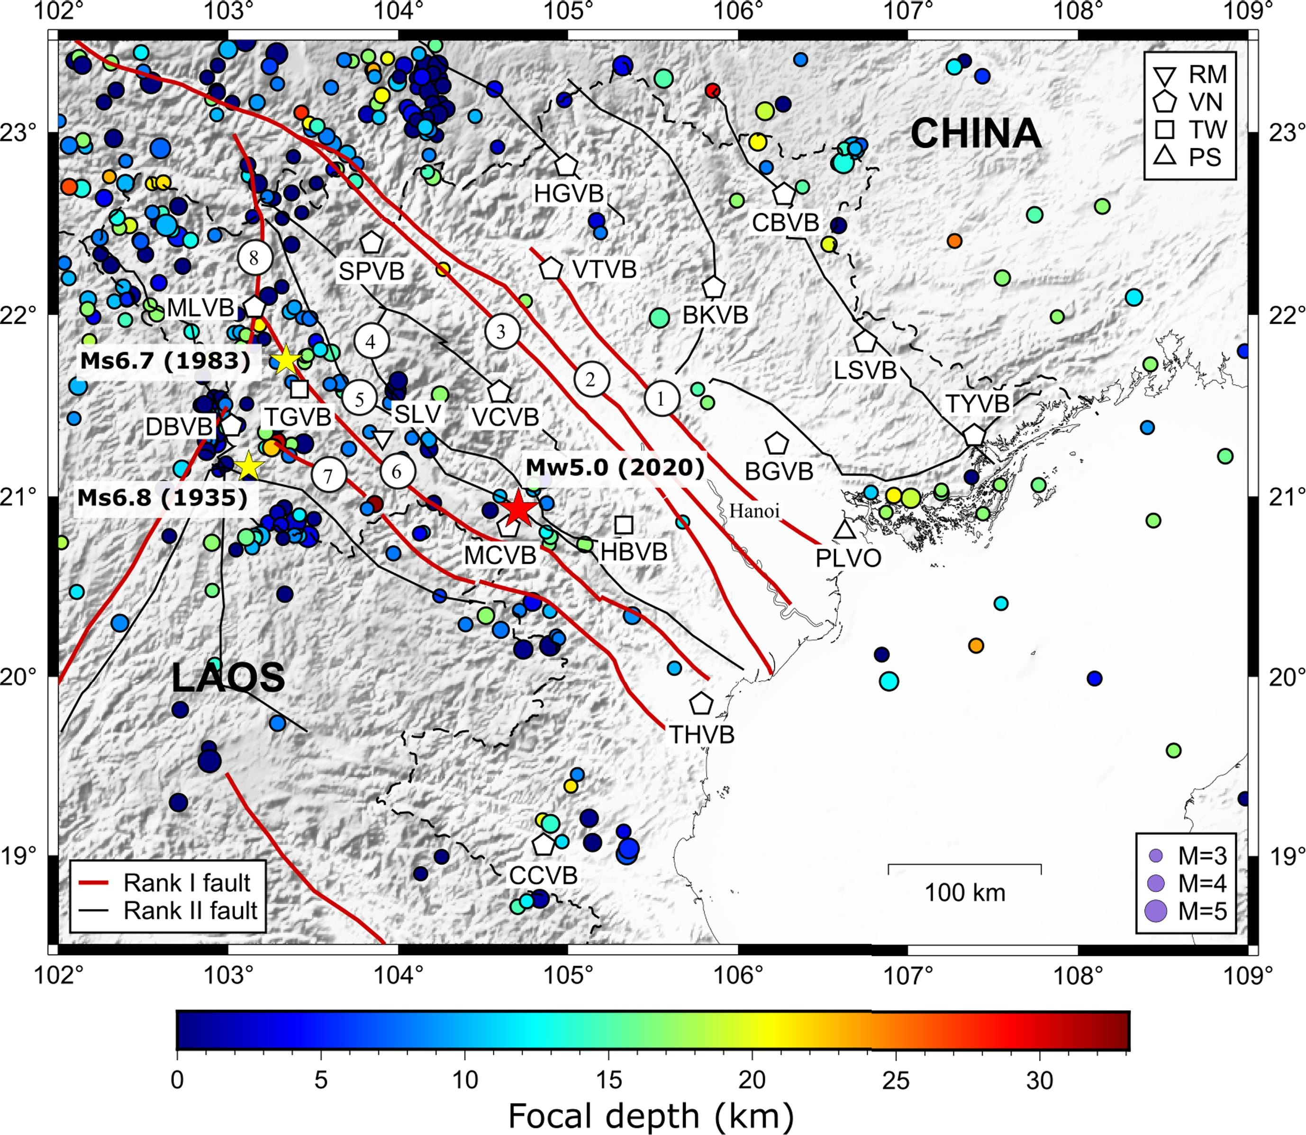
Northern Vietnam Monitoring System
VNNET and other Broadband Stations in Northern Vietnam, where seismicity is relatively higher than other area in Vietnam
2026- 2031: 30 stations are planned to be deployed.
Detected events from 1990-2020
Nguyen et al., 2021
Ha, 2025

Slide 7
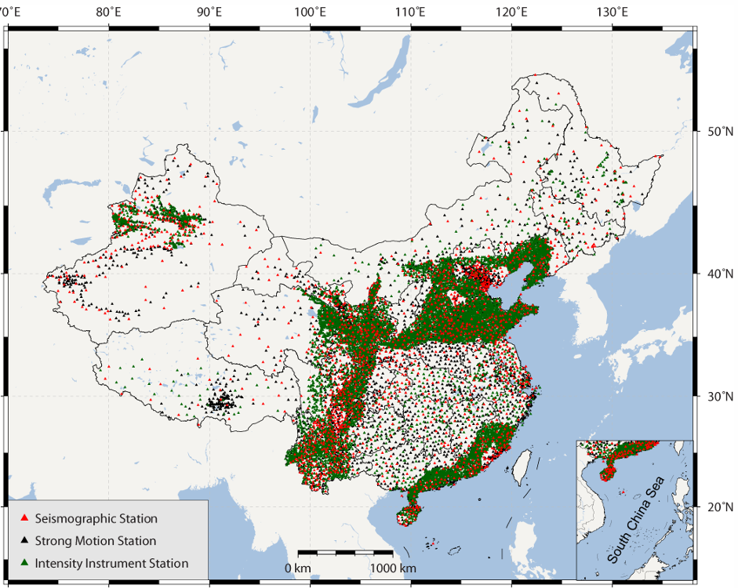
China Earthquake Administration: Chinese Seismic Network
Updated in 2025
18,000 real-time stations
  3000 velocity stations
  5000 strong motion
  10,000 intensity (MEMS) stations
HDF5 event waveform data ranging from 200 to 300 s long
Restricted dataset
Dai and An, 2017

Slide 8
Thank you.

