Slide 1
Suggested Updates to
Framework for Adoption of Features within FDSN Working Groups
FDSN

Slide 2
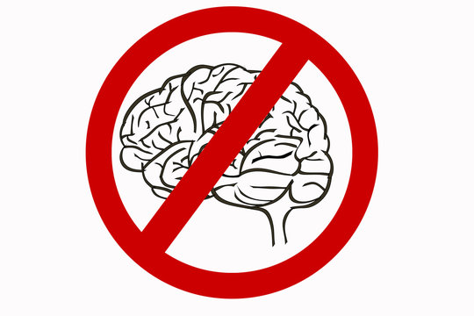
Why make Changes
Text is not well organized and is unclear in places
There is no mechanism for rapid adoption of features that are of obvious benefit

Slide 3
Suggested Updates
Reorganize content to make text more understandable
Add a flowchart for both Type A and Type B proposals
Allow the WG lead to bypass the formal proposal review and proposal phase vote for Type A proposals with clear objectives and no requirements that need to be set

Slide 4
Type A
Type B

